Slide 1
E - COMMERECE ANALYSIS
Group 5

Slide 2
Topics Covered
Summary of the Project
Excel Dashboard
Power BI Dashboard
Tableau Dashboard
My SQL
Suggestions and overview
Q & A

Slide 3
Summary
This dataset contains real-world e-commerce data from a marketplace, which contains the entire customer journey—from browsing products and placing orders to payment processing, delivery tracking, and customer reviews.
This dataset was analyzed and visualized using tools like Excel, Power BI, Tableau, and SQL.

Slide 4
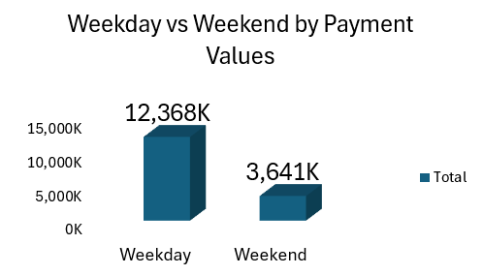
Excel Dashboard
This is one of the KPI used to visualize the data.
The chart displays the difference in payment values of products on weekdays and weekends.
The visualization helps identify potential trends in consumer spending behavior based on the day of the week.

Slide 5
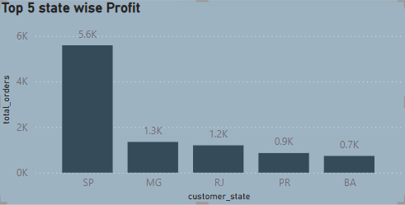
Power BI
This is one of the KPI used to visualize the data.
This chart shows the profit values of the top-performing states.
It ranks states based on their profitability, highlighting the highest sales based on the states.
The visualization helps identify which states contribute the most to overall profits.

Slide 6
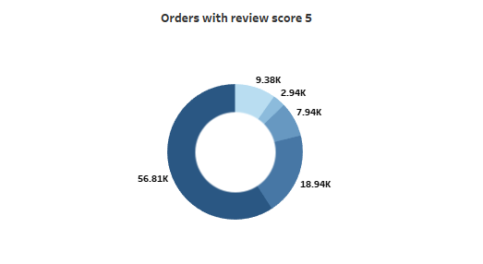
Tableau
This is one of the KPI used to visualize the data.
The chart displays the number of orders with a review score of 5, showing variations across different categories.
This visualization helps identify trends in customer satisfaction, with the majority of top-rated orders concentrated in specific segments.

Slide 7
SQL
It computes the proportion of cancelled orders by dividing the count of orders with order_status = cancelled, by the total number of orders, then multiplies by 100 to convert it into a percentage.
This query calculates the customer repeat rate, which represents the percentage of customers who placed more than one order in the olist_orders dataset.

Slide 8
Overview
The dataset tracks e-commerce KPIs (profit, payments, orders) and visualizes trends by payment method, region, time, and product categories, with credit cards dominating payments and São Paulo (SP) leading in orders.
Added interactive slicers to the dashboard for data exploration. Users can now filter KPIs by categories like time period, region, or customer segment with a single click, enabling faster insights and decision-making.

Slide 9
Q & A

Slide 10
Thank you

